Slide 1

UNIVERSITY COLLEGE OF ENGINEERING KANCHEEPURAM COMPUTER SCIENCE AND ENGINEERING
STOCHASTIC GRADIENT DESCENT BASED
HATE SPEECH DETECTION IN SOCIAL NETWORKS
BATCH MEMBERS :
1. GOKUL S (513419104015)
2 HARIPRAKASH M (513419104017)
3.KISHORE KUMAR M (513419104023)
GUIDED BY –Mrs.T.Kala M.E(Ph.d)
Assistant Professor, Dept. of CSE

Slide 2
ABSTRACT
The detection of hate speech in social media is a crucial task.
The uncontrolled spread of hate has the potential to gravely damage our society, and severely harm marginalized people or groups.
As online content continues to grow, so does the spread of hate speech.
The Project identifies and examine challenges faced by online automatic approaches for hate speech detection in text.
Among these difficulties are subtleties in language, differing definitions on what constitutes hate speech, and limitations of data availability for training and testing of these systems.
Furthermore, many recent approaches suffer from an interpretability problem-that is, it can be difficult to understand why the systems make the decisions that they do.

Slide 3
INTRODUCTION
Hate speech detection is the task of detecting if communication such as text and so on contains hatred and or encourages violence towards a person or a group of people.
This is usually based on prejudice against 'protected characteristics' such as their ethnicity, gender, sexual orientation, religion, age et al.
The automatic detection of hate speech is a challenging task due to disagreements on different hate speech definitions.
Therefore, some content might be hateful to some individuals and not to others, based on their concerned definitions.

Slide 4
AIM / OBJECTIVE
Hate speech is a big problem on the internet. It can be found on social media, in comment sections, and even in online forums.
Machine learning algorithms can be used to detect hate speech.
These algorithms can analyze text and identify hate speech.
They can also be used to determine the tone of a text.
This can be used to identify hate speech that is disguised as jokes or sarcasm.
This project uses Machine learning algorithm and NLP to detect the hate speech.

Slide 5
OBSERVATION/MOTIVATION
The nature of social media means that anyone can post anything they desire, putting forward any position, whether it is enlightening, repugnant or anywhere between. Depending on the forum, such posts can be visible to many millions of people. Different forums have different definitions of inappropriate content and different processes for identifying it, but the scale of the medium means that automated methods are an important part of this task. Hate-speech is an important aspect of this inappropriate content
Hate-speech is a subjective and complex term with no single definition, however. Irrespective of the definition of the term or the problem, it is clear that automated methods for detecting hate-speech are necessary in some circumstances.

Slide 6
EXISTING SYSTEM
The machine learning algorithms that can be used to detect hate speech include Naive Bayes, Support Vector machines (SVM), extreme gradient boosting (XGBoost), multi-layer perceptron (MLP).
The hate speech data sets are usually not clean, so they need to be pre-processed before classification algorithms can detect hate speech in them. Different machine learning models have different weakness.
Traditional text classification methods based on machine learning have many disadvantages such as dimension explosion, data sparsity, limited generalization ability.

Slide 7
LITERATURE REVIEW (CONT..I)
S.NO | TITLE | AUTHOR NAME | YEAR & PUBLICATION | CONTEXT
1. | Cross-Lingual Few-Shot Hate Speech and Offensive Language Detection Using Meta Learning | Marzieh Mozafari; Reza Farahbakhsh; Noel Crespi | 2022 & IEEE | Experiments show that meta learning-based models outperform transfer learning-based models in a majority of cases, and that Proto-MAML is the best performing model, as it can quickly generalize and adapt to new languages
2. | Hate Speech Detection using Machine Learning | P. Preethy Jemima; Bishop Raj Majumder; Bibek Kumar Ghosh; Farazul Hoda | 2022 & IEEE | Data from social media sites such as Twitter are used to test the effectiveness of these procedures, and they reveal a 6 percentage point improvement in macro-average F1 or a 9 percent improvement for content that has been labeled as hateful, respectively.

Slide 8
LITERATURE REVIEW (CONT..II)
S.NO | TITLE | AUTHOR NAME | YEAR & PUBICATION | CONTEXT
3. | PDHS: Pattern-Based Deep Hate Speech Detection With Improved Tweet Representation | P. Sharmila; Kalaiarasi Sonai Muthu Anbananthen; Deisy Chelliah; Sudhaman Parthasarathy; Subarmaniam Kannan | 2022 & IEEE | The experimental results on Twitter Dataset can learn effective features to enhance the performance with minimum training time and attained 88%F1Score.
4. | Deep Learning Based Fusion Approach for Hate Speech Detection | Yanling Zhou; Yanyan Yang; Han Liu; Xiufeng Liu; Nick Savage | 2020 & IEEE | The ExperimeNt shows that the accuracy and F1-score of the classification are significantly improved.

Slide 9
PROPOSED WORK
This project uses SGD for hate speech classifications. SGD stands for Stochastic Gradient Descent .
Stochastic Gradient Descent (SGD) is a variant of the Gradient Descent algorithm used for optimizing machine learning models. In this variant, random training example is used to calculate the gradient and update the parameters at each iteration.
SGD is still computationally much less expensive than typical Gradient Descent. Hence, in most scenarios, SGD is preferred over Batch Gradient Descent for optimizing a learning algorithm.

Slide 10
SYSTEM REQUIREMENTS
Software Requirements:
Hardware Requirements:
Python
Prefered IDE
Necessary Modules
LAPTOP WITH 2GB RAM

Slide 11
LIST OF MODULES
A system module consits of Text preprocessing involves transforming text into a clean and consistent format that can then be fed into a model for further analysis and learning.
A regular expression is a pattern that the regular expression engine attempts to match in input text. A pattern consists of one or more character literals, operators, or constructs.
Natural language processing (NLP) is a subfield of linguistics, computer science, and artificial intelligence concerned with the interactions between computers and human language, in particular how to program computers to process and analyze large amounts of natural language data.

Slide 12
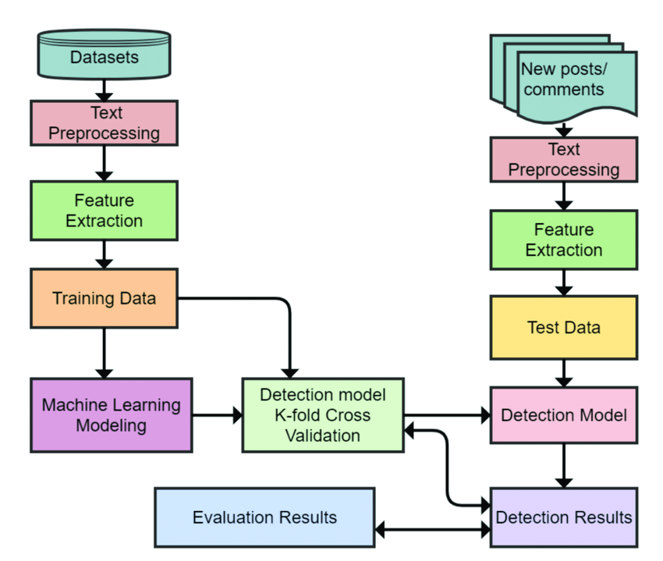
ARCHITECTURE DIAGRAM

Slide 13
CONCLUSION
As hate speech continues to be a societal problem, the need for automatic hate speech detection systems becomes more apparent.
This project presents the current approaches for this task as well as a new system that achieves reasonable accuracy.
This project also proposed a new approach that can out perform existing systems at this task, with the added benefit of improved interpretability.

Slide 14
REFERENCES ( CONT.. I)
P. K. Jain, V. Saravanan, and R. Pamula, ‘‘A hybrid CNN-LSTM: A deep learning approach for consumer sentiment analysis using qualitative usergenerated contents,’’ ACM Trans. Asian Low-Resource Lang. Inf. Process., vol. 20, no. 5, pp. 1–15, Sep. 2021.
A. Kamaal and M. Abulaish, ‘‘CAT-BiGRU: Convolution and attention with bi-directional gated recurrent unit for self-deprecating sarcasm detection,’’ Cognit. Comput., vol. 14, pp. 91–109, Jan. 2021.
P. K. Jain, R. Pamula, and E. A. Yekun, ‘‘A multi-label ensemble predicting model to service recommendation from social media contents,’’ J. Supercomput., vol. 66, no. 1, pp. 1–20, Sep. 2021.

Slide 15
REFERENCES(CONT.. II)
E. W. Pamungkas, V. Basile, and V. Patti, ‘‘A joint learning approach with knowledge injection for zero-shot cross-lingual hate speech detection,’’ Inf.Process. Manage., vol. 58, no. 4, pp. 1–19, 2021.
K. Miok, B. Skrlj, D. Zaharie, and M. Robnik-Sikonja, ‘‘To ban or not to ban: Bayesian attention networks for reliable hate speech detection,’’ Cognit. Comput., vol. 21, no. 1, pp. 1–19, 2021.
S. Kiritchenko, I. Nejadgholi, and K. C. Fraser, ‘‘Confronting abusive language online: A survey from the ethical and human rights perspective,’’ J. Artif. Intell. Res., vol. 71, pp. 431–478, Jul. 2021

